Slide 1


IMPROVING SALES REVENUE FOR THE BUSINESS BY USING SUPERVISED MACHINE LEARNING
Guided by,
Mrs. Gokilavani A
Head of the Department
Department of Computer science and Engineering
Jai Shriram Engineering College
Prepared By,
Jeyaprakash R - 711218104016
Makeshkumar M - 711218104026
Sasikumar S - 711218104042

Slide 2
Abstract
The project for sales forecasting is used to predict the demand of customers over time for goods and services.
It includes the company's projected revenue forecast in the business unit in a time schedule.
The prediction for sales and profits is one of the most critical activities when the investor considers the production schedule challenging.
The program is used to predict the needs of the owner and has other benefits as well as time management features.
Forecasting is very difficult to do in manually. Therefore, it is proposed that the mechanism be computerized by designing the relative applications, as the environment is knowledge and technology.

Slide 3
Introduction
Data analytics is the science of analysing raw data to make conclusions about that information.
A sales forecast is a prediction of future sales revenue. Sales forecasts are usually based on historical data, industry trends, and the status of the current sales pipeline.
Businesses use the sales forecast to estimate weekly, monthly, quarterly, and annual sales totals.

Slide 4
Objective
To develop and implement a forecasting that will be dedicated to perform the maintenance tasks.
This project deals with the sales forecasting. This system is used for daily activities such as sales, customer details, demand status, status check, and managing sales forecasting. It is very difficult to do this process manually.
This is a software application, which avoids more manual hours that need to spend in record keeping of details and generating forecasting reports.

Slide 5
Literature Review
S.NO | TITLE | JOURNAL NAME | YEAR | AUTHOR | CONTENT
1 | Sales Prediction based on Machine Learning | International Conference on E-Commerce and Internet Technology (ECIT) | 2021 | Zixuan Huo | The accurate forecast of the sales volume of e-commerce platforms is done by using Machine Learning
2 | Clothing Sale Forecasting by a Composite GRU–Prophet Model With an Attention Mechanism | IEEE Transactions on Industrial Informatics | 2021 | Yuanjiang Li; Yi Yang; Kai Zhu; Jinglin Zhang | It helps enterprises be more competitive in the field of smart manufacturing.
3 | Maximizing Inventory Backorder Prediction System Using Big Data Analytics | IEEE Access | 2020 | Petr Hajek; Mohammad Zoynul Abedin | Prediction model shows better prediction and profit function performance

Slide 6
Existing System
Traditional System was used for sales prediction.
The traditional system is a manual one in which users are maintaining ledgers, books etc. to store the information like customer details, analyzing sales, sales details, details of payments, and customer demands.
It is very difficult to maintain historical data. Also regular investments need to purchase station every year.

Slide 7
Disadvantage
It is difficult to maintain important information in books and ledgers.
More manual hours need to analyze demand list and required reports
Daily sales and demand are to be entering into different books immediately to avoid conflicts which are very difficult.
No co-ordination between different customers because we are not storing the data at centralized location.
Data operates based on stored procedure.

Slide 8
Proposed System
Register and Upload the datasets to predict future sale
Predicted output can be seen in chart format
Predicted output can be download in pdf format
Search and view particular categories of dataset
Accurate prediction
Implement XGBoost methodology
Supervised Learning with Regression And Classification Model with Algorithm compression Statistical analysis with Prediction Method

Slide 9
Advantages
Reduce excess inventory
Fewer Stock shortages which result when demand exceeds supply
Fewer unnecessary production line changes to fulfil unanticipated demand
Less overtime hours through improved prediction in personnel requirements

Slide 10
Modules
Data Collection
Pre-processing and Cleaning
Modeling
Prediction

Slide 11
Data Collection
Provide the information in the form of balance sheets and sales records. This information is used to perform a trend analysis of data and forecast the overall growth of a company in future.
The data set is collected from the kaggle data science company.

Slide 12
Pre-processing and Cleaning
Data Cleaning
The data can have many irrelevant and missing parts.
Data Transformation
This step is taken in order to transform the data in appropriate forms suitable for mining process.
Data Reduction
Since data mining is a technique that is used to handle huge amount of data.

Slide 13
Modeling
XGBoost
Train test split
Scale the data
Reverse scaling
Create a predictions data frame
Score the models

Slide 14
Gradient Boosting Classifier
Training Data
Gradient boosting classifier
Reduce bias & variance
Breaks Data set into smaller subsets
XGBoost
Data
Recursively repeat the process for each child
Test Data
Performance Evaluation Measure
Accuracy
Precision
Model Evaluation

Slide 15
Gradient Boosting Classifiers
Gradient boosting classifiers are a group of machine learning algorithms that combine many weak learning models together to create a strong predictive model
Boosting
This is done by building a model from the training data, then creating a second model that attempts to correct the errors from the first model.

Slide 16
Working Principle
Dataset
Pre –Processing
Cleaning
EDA (Explore Data Analysis)
Data Split
Data Processing
Feature Selection
Modelling
Prediction
Future Sales data
User Input

Slide 17
Methodology
Front-end
HTML
CSS
Jquery,JS
Back-end
SQLite
Server
Django-framework

Slide 18
Flow Diagram
Login
Upload Sales File
View All uploaded File
View data by category
View predicted sales value in Historical data Graph
View predicted sales value in Table format
View all data present in the file with Historical Graph

Slide 19
Software and package requirements
Python 3.7.0
Django 2.0
Joblib 0.13.2
mysql-connector-python 8.0.17
numpy 1.17.1
pandas 0.25.1
patsy 0.5.1
python-dateutil 2.8.0
pytz 2019.2
scikit-learn 0.21.3
scipy 1.3.1
six 1.12.0
sklearn 0.0
statsmodels 0.10.1
Xampp 7.1

Slide 20
Hardware and software specification
Hardware requirements:
Processor: Core i3 (8th Generation)
Ram: 2.6 GHZ, 8 GB RAM
Windows Operating System 10
Software requirements:
Windows 10 Pro 64 Bit

Slide 21
Conclusion
Sales forecasting is the key part of the strategic planning process and allow a company to predict the future performance of its business. It enables them not only to plan for new opportunities but also to prevent negative trends in the forecast.
The decision maker can allow the forecaster to articulate the forecasted issue correctly by knowing the specific features and shortcomings of the tools and may thus have more trust in and using the forecasts more efficiently.

Slide 22
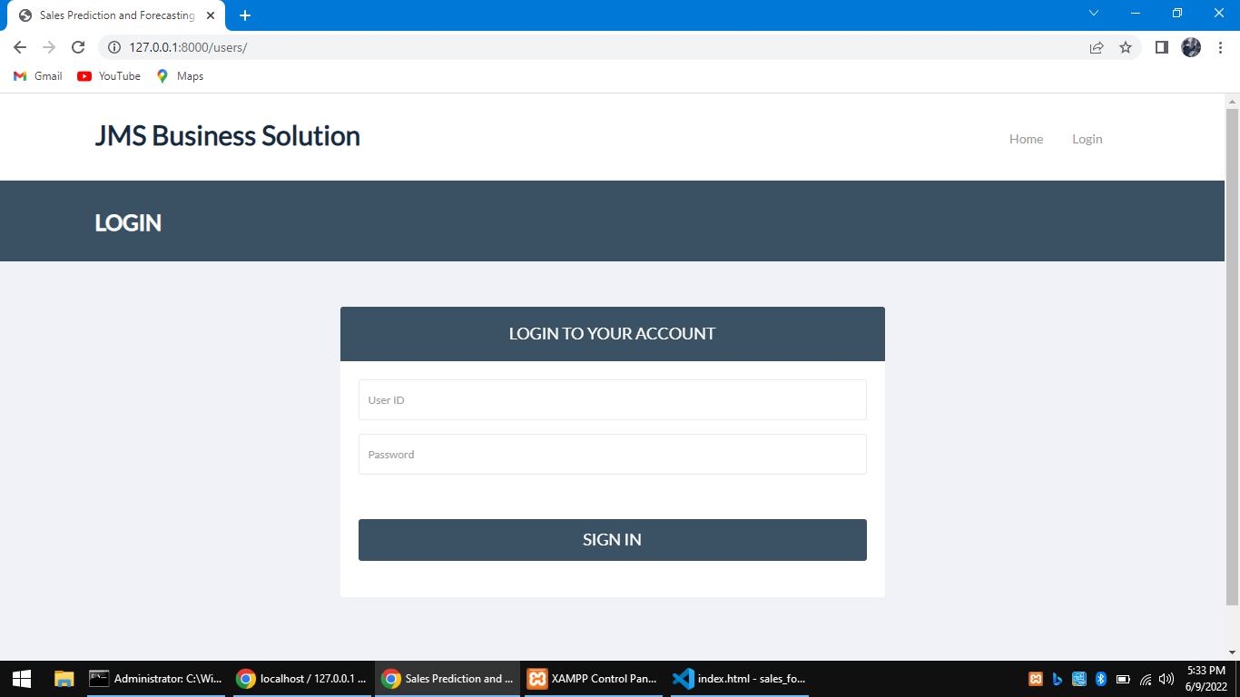
Login

Slide 23
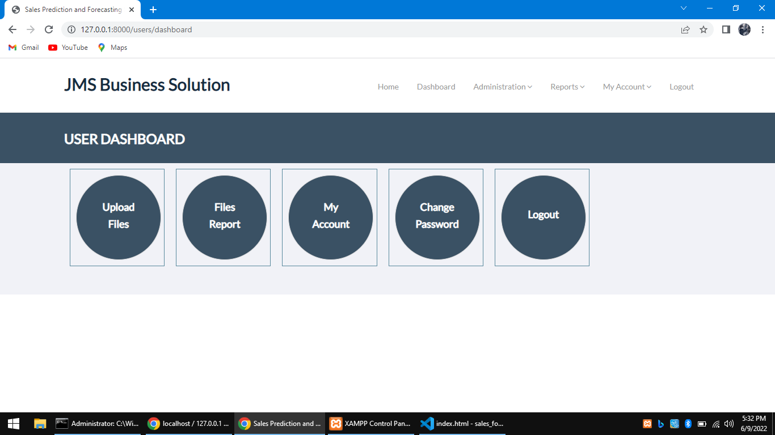
Dashboard

Slide 24
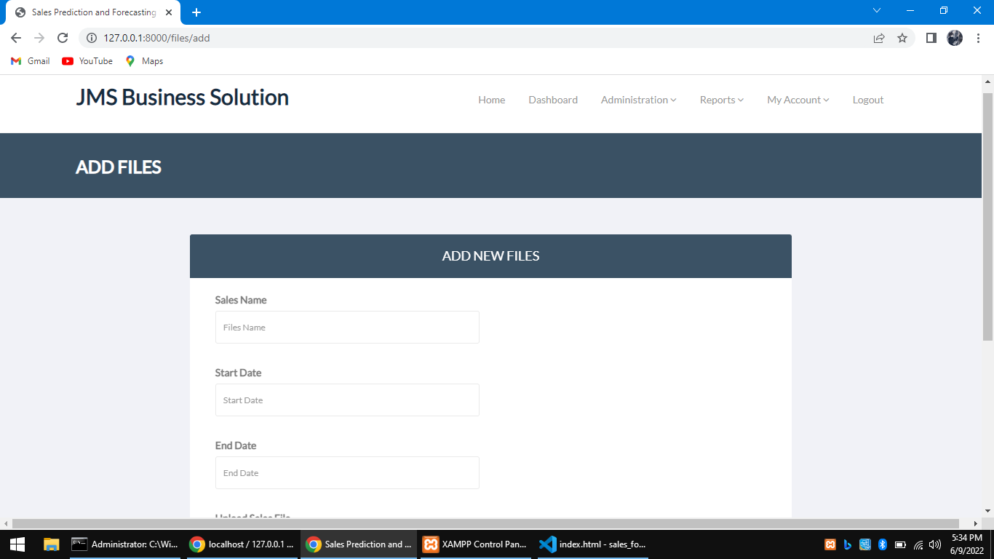
Upload Sales file

Slide 25
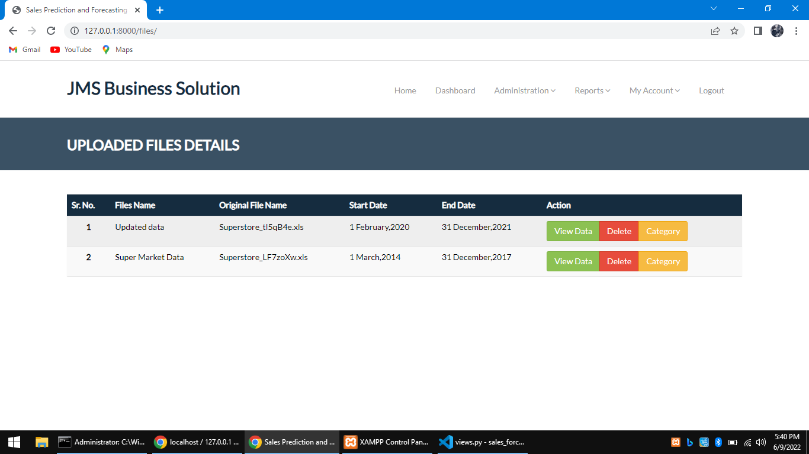
Uploaded all files

Slide 26
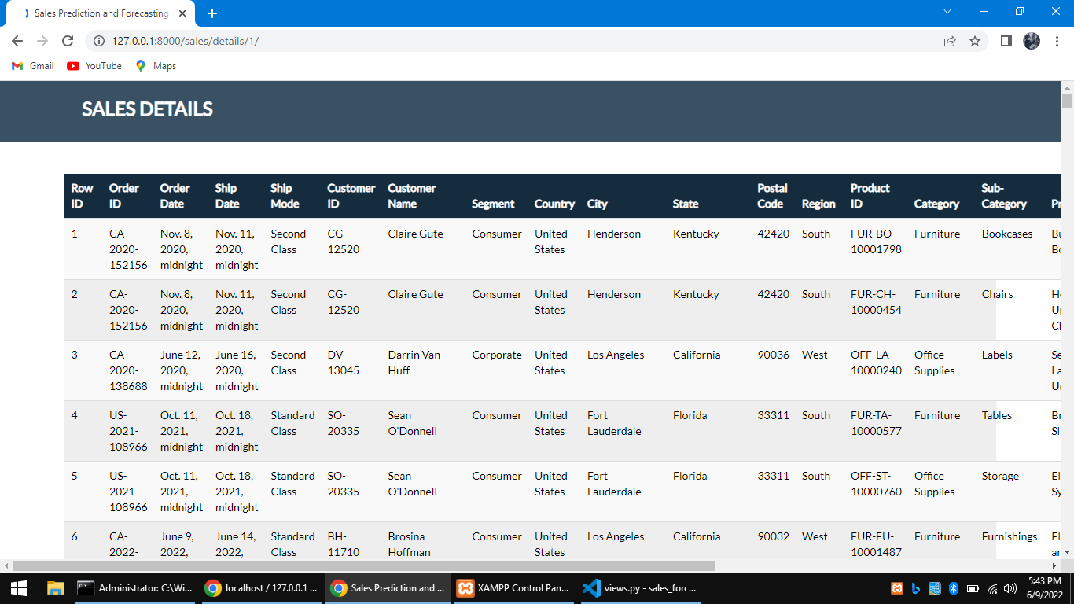
View all data in file

Slide 27
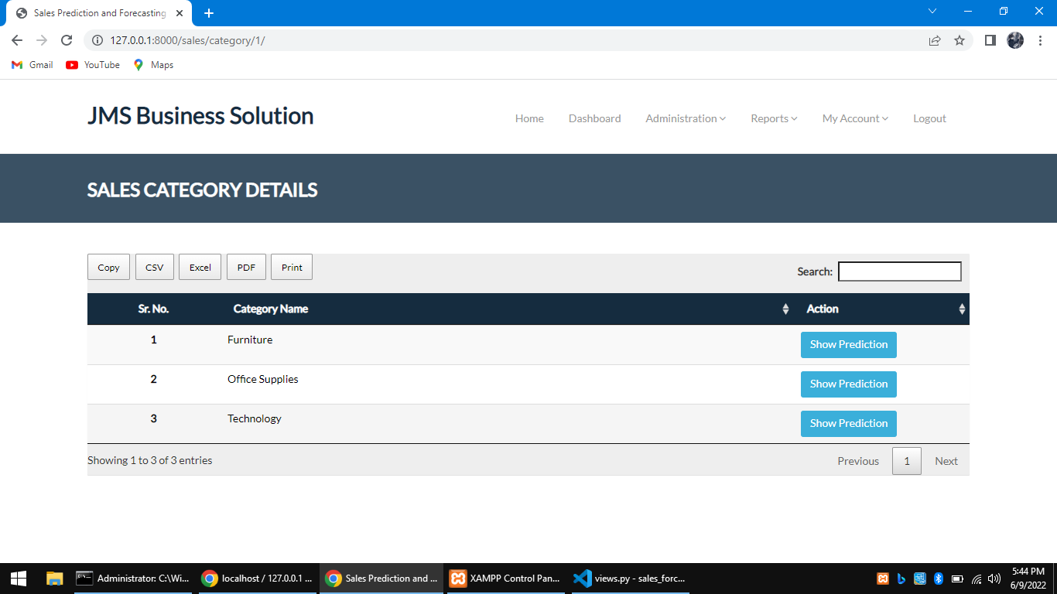
View by category

Slide 28
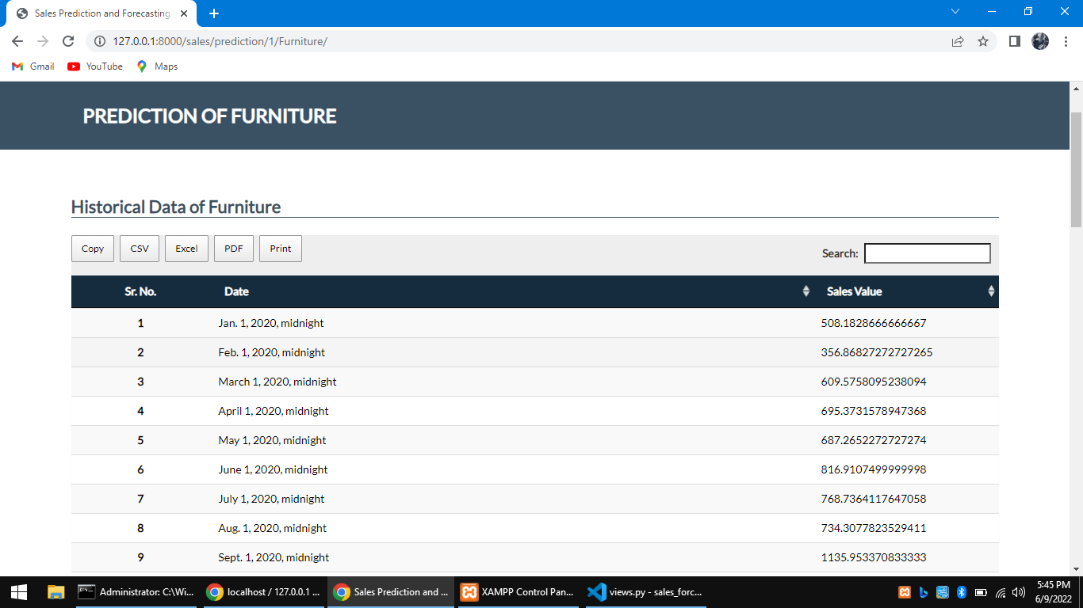
Sales value in each month

Slide 29
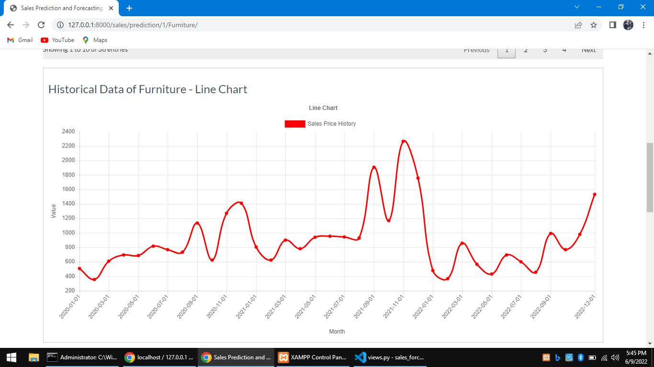
Historical graph for sold data

Slide 30
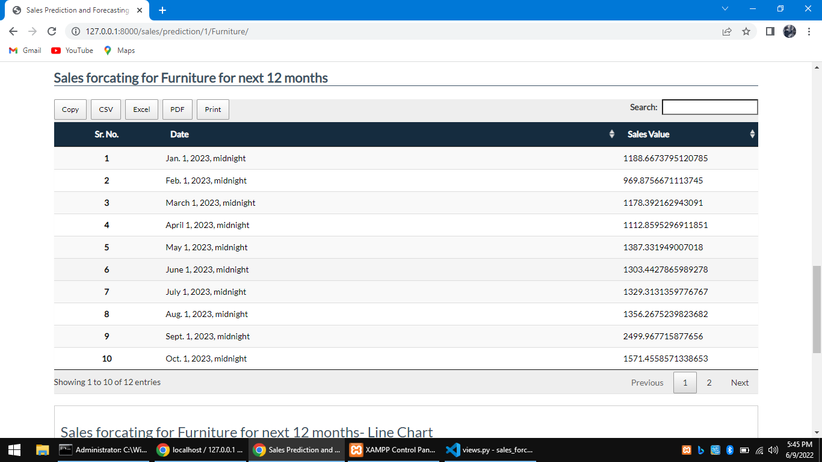
Next 12 Month sales value

Slide 31
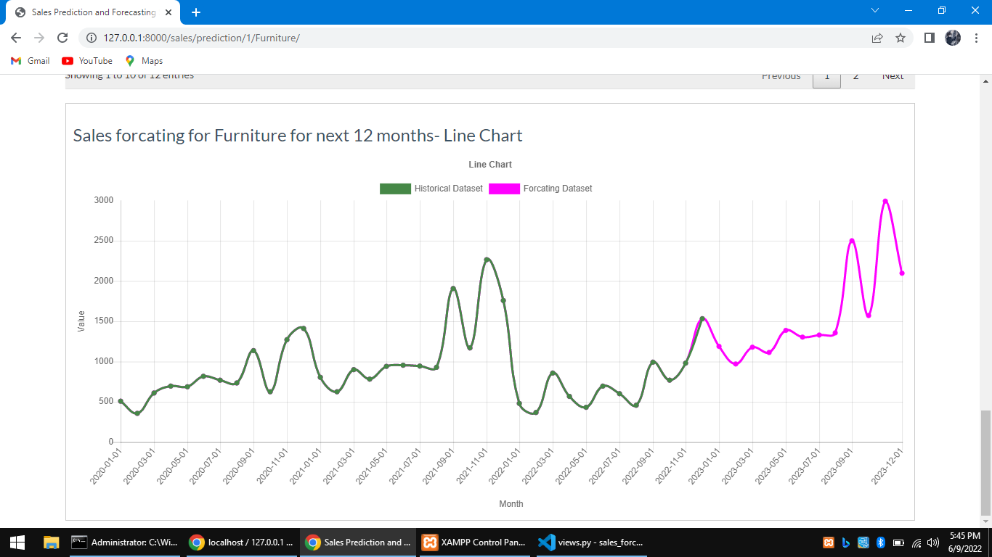
Forecast in Historical graph

Slide 32
Reference
Ahmed A.A. Gad-Elrab, (2021) "Modern Business Intelligence: Big Data Analytics and Artificial Intelligence for Creating the Data-Driven Value", E-Business - Higher Education and Intelligence Applications.
Choi .T , C. Hui, S. Ng and Y. Yu, (2019) "Color Trend Forecasting of Fashionable Products with Very Few Historical Data," in IEEE Transactions on Systems, Man, and Cybernetics, Part C (Applications and Reviews), vol. 42, no. 6, pp. 1003-1010, DOI: 10.1109/TSMCC.2011.2176725.
Hu Zhang, Zhaohui Tang, Yongfang Xie, He Yuan, Qing Chen, Weihua Gui, (2022) "Siamese Time Series and Difference Networks for Performance Monitoring in the Froth Flotation Process", IEEE Transactions on Industrial Informatics, vol.18, no.4, pp.2539-2549.

Slide 33
Reference contd..
Hajek .P and M. Z. Abedin, (2020) "A Profit Function-Maximizing Inventory Backorder Prediction System Using Big Data Analytics," in IEEE Access, vol. 8, pp. 58982-58994, DOI: 10.1109/ACCESS.2020.2983118.
Huang, Z. Dou, Y. Hu and R. Huang, (2021) "Online Sales Prediction: An Analysis with Dependency SCOR-Topic Sentiment Model," in IEEE Access, vol. 7, pp. 79791-79797, DOI: 10.1109/ACCESS.2019.2919734.
Khan et al., (2020) "Effective Demand Forecasting Model Using Business Intelligence Empowered With Machine Learning," in IEEE Access, vol. 8, pp. 116013-116023, DOI: 10.1109/ACCESS.2020.3003790.

Slide 34
Reference contd..
Li .Y, Y. Yang, K. Zhu and J. Zhang, (2021) "Clothing Sale Forecasting by a Composite GRU–Prophet Model With an Attention Mechanism," in IEEE Transactions on Industrial Informatics, vol. 17, no. 12, pp. 8335-8344, DOI: 10.1109/TII.2021.3057922.
S. Ren, T. Choi and N. Liu, (2019) "Fashion Sales Forecasting With a Panel Data-Based Particle-Filter Model," in IEEE Transactions on Systems, Man, and Cybernetics: Systems, vol. 45, no. 3, pp. 411-421, DOI:10.1109/TSMC.2014.2342194.

Slide 35
Reference contd..
Y. Weng, X. Wang, J. Hua, H. Wang, M. Kang and F. Wang, (2019) "Forecasting Horticultural Products Price Using ARIMA Model and Neural Network Based on a Large-Scale Data Set Collected by Web Crawler," in IEEE Transactions on Computational Social Systems, vol. 6, no. 3, pp. 547-553, DOI: 10.1109/TCSS.2019.2914499.
Zhaoweijie, Chenliang and Hujiangmin, (2020) "Forecast Rossmann Store Sales Base on Xgboost Model," 2020 2nd International Conference on Economic Management and Model Engineering (ICEMME), pp. 521-525, DOI: 10.1109/ICEMME51517.2020.00110

Slide 36
THANK YOU

